Slide 1
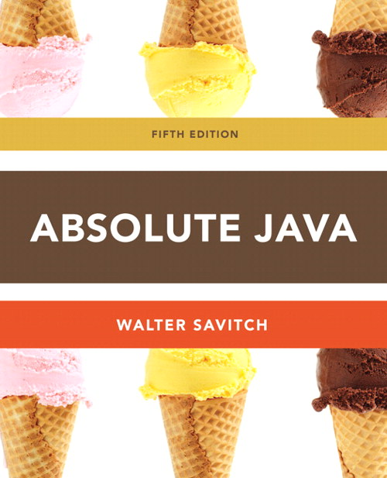
Chapter 16
Collections, Maps and Iterators
Slides prepared by Rose Williams, Binghamton University
Kenrick Mock, University of Alaska Anchorage

Slide 2
Collections
A Java collection is any class that holds objects and implements the Collection interface
For example, the ArrayList<T> class is a Java collection class, and implements all the methods in the Collection interface
Collections are used along with iterators
The Collection interface is the highest level of Java's framework for collection classes
All of the collection classes discussed here can be found in package java.util

Slide 3
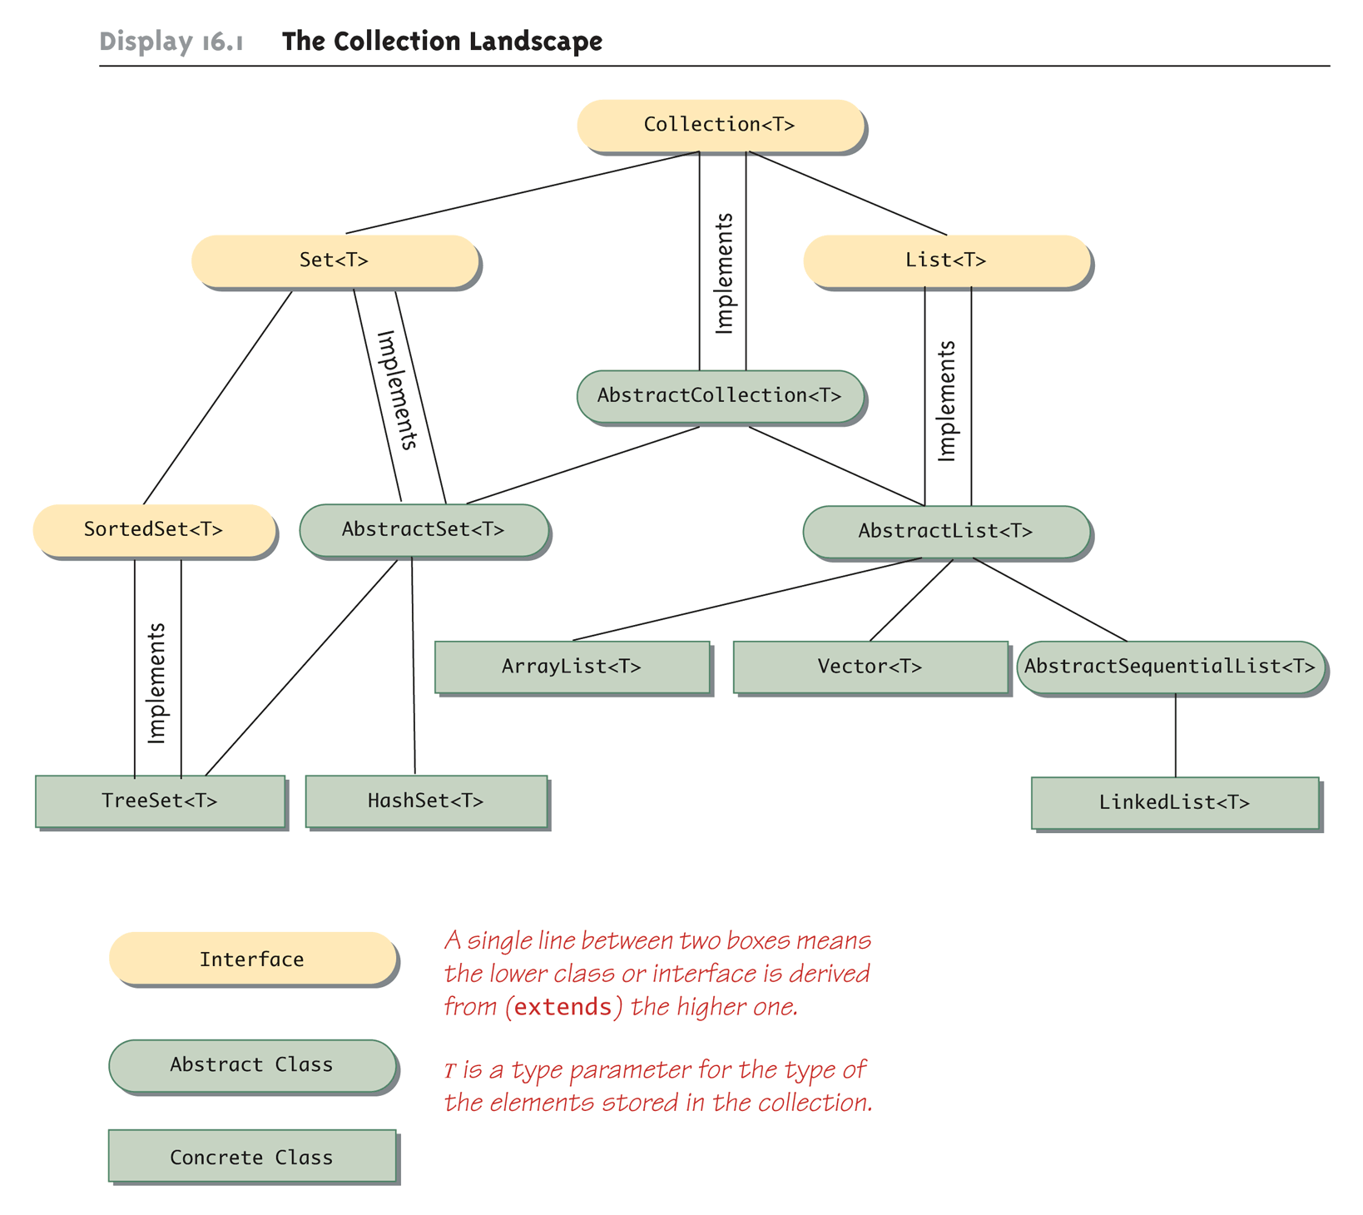
The Collection Landscape

Slide 4
Wildcards
Classes and interfaces in the collection framework can have parameter type specifications that do not fully specify the type plugged in for the type parameter
Because they specify a wide range of argument types, they are known as wildcards
public void method(String arg1, ArrayList<?> arg2)
In the above example, the first argument is of type String, while the second argument can be an ArrayList<T> with any base type

Slide 5
Wildcards
A bound can be placed on a wildcard specifying that the type used must be an ancestor type or descendent type of some class or interface
The notation <? extends String> specifies that the argument plugged in be an object of any descendent class of String
The notation <? super String> specifies that the argument plugged in be an object of any ancestor class of String

Slide 6
The Collection Framework
The Collection<T> interface describes the basic operations that all collection classes should implement
The method headings for these operations are shown on the next several slides
Since an interface is a type, any method can be defined with a parameter of type Collection<T>
That parameter can be filled with an argument that is an object of any class in the collection framework

Slide 7
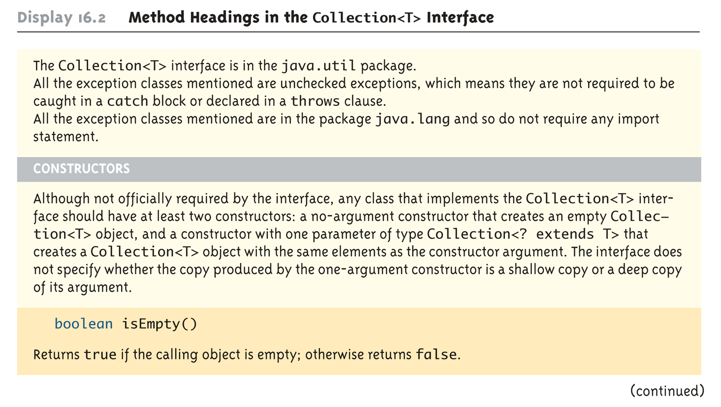
Method Headings in the Collection<T> Interface (Part 1 of 10)

Slide 8
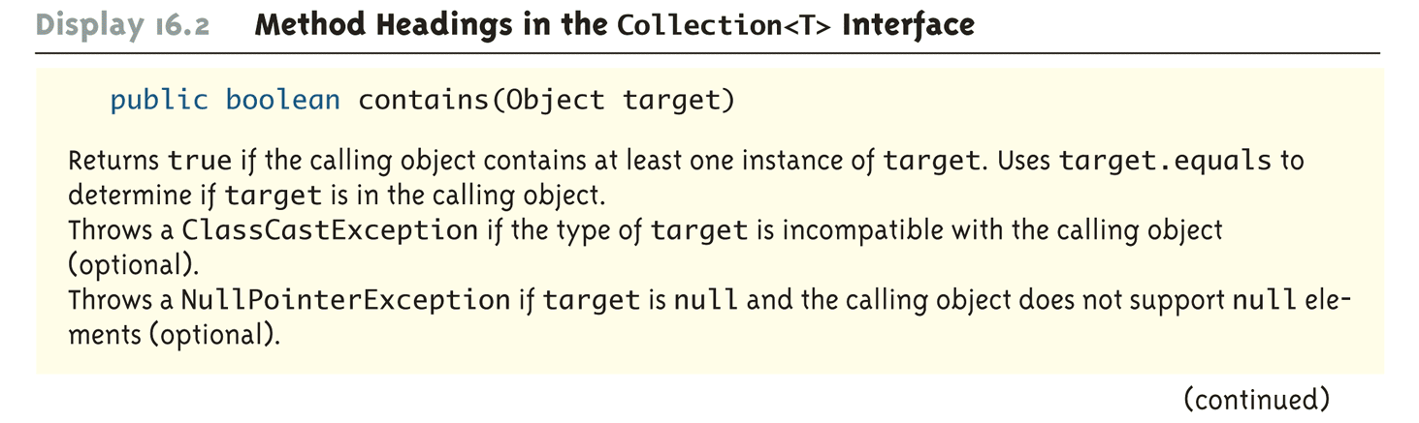
Method Headings in the Collection<T> Interface (Part 2 of 10)

Slide 9
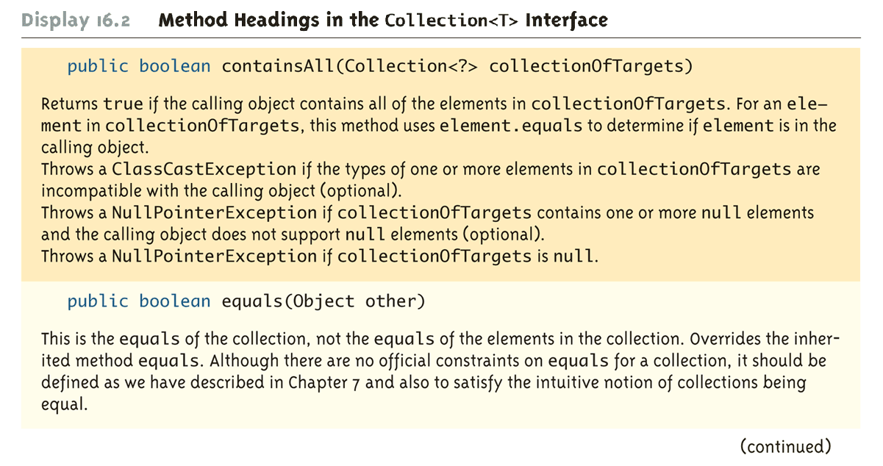
Method Headings in the Collection<T> Interface (Part 3 of 10)

Slide 10
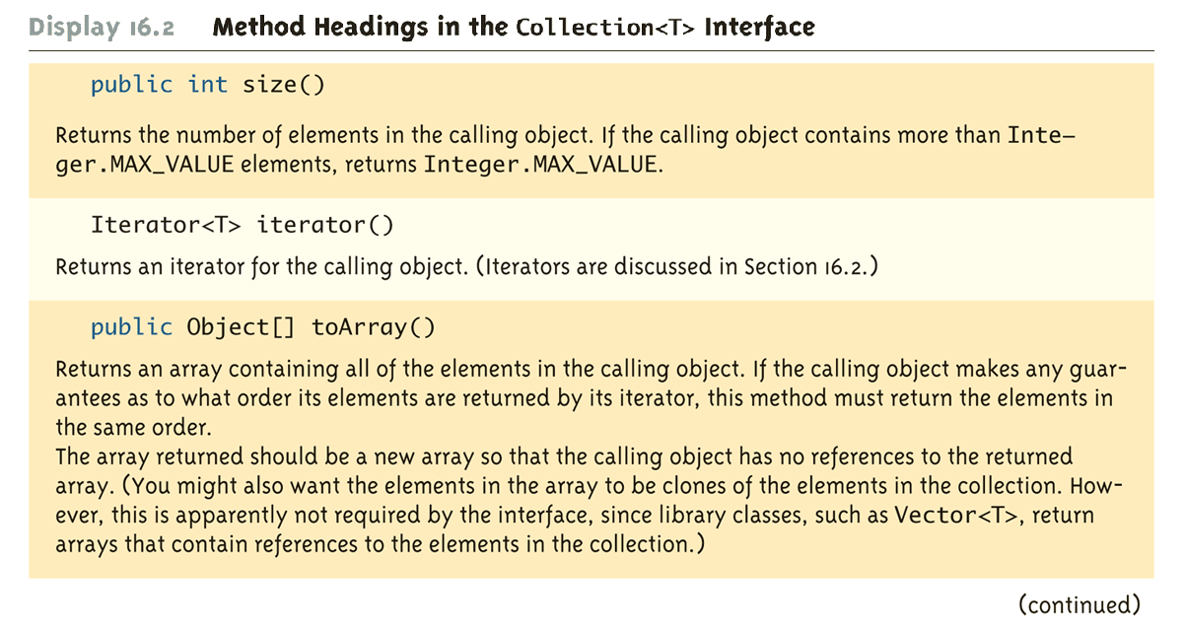
Method Headings in the Collection<T> Interface (Part 4 of 10)

Slide 11
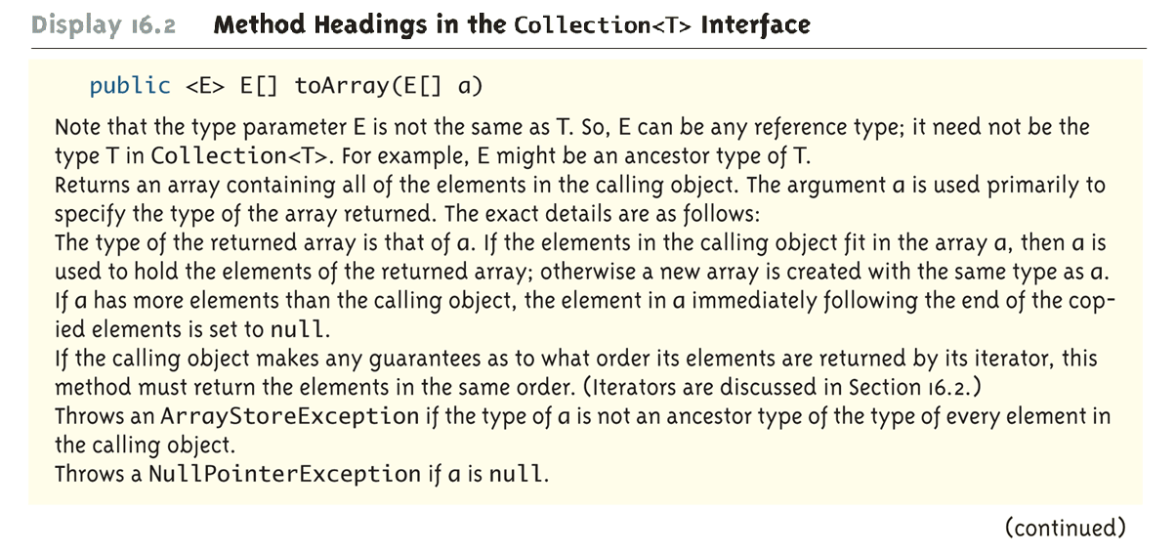
Method Headings in the Collection<T> Interface (Part 5 of 10)

Slide 12
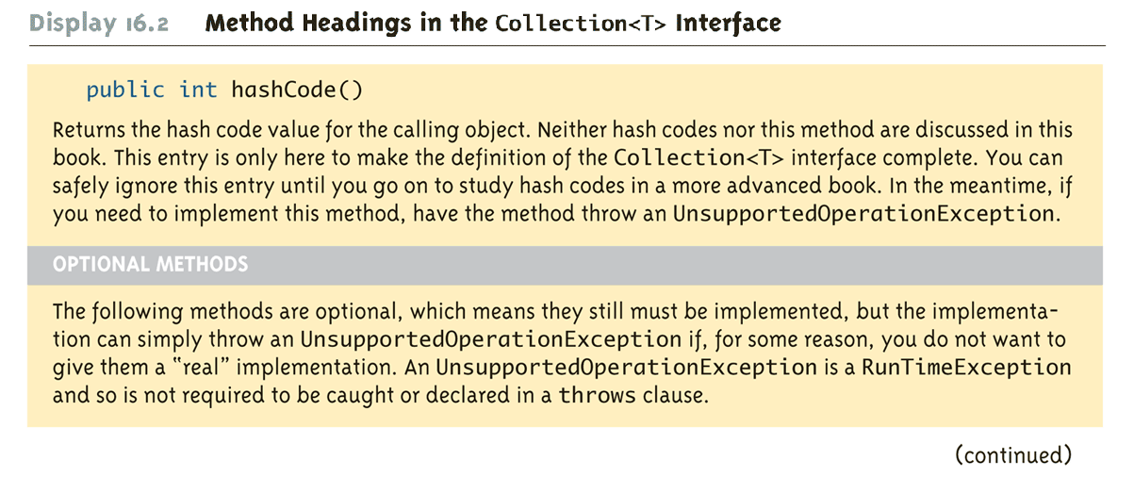
Method Headings in the Collection<T> Interface (Part 6 of 10)

Slide 13
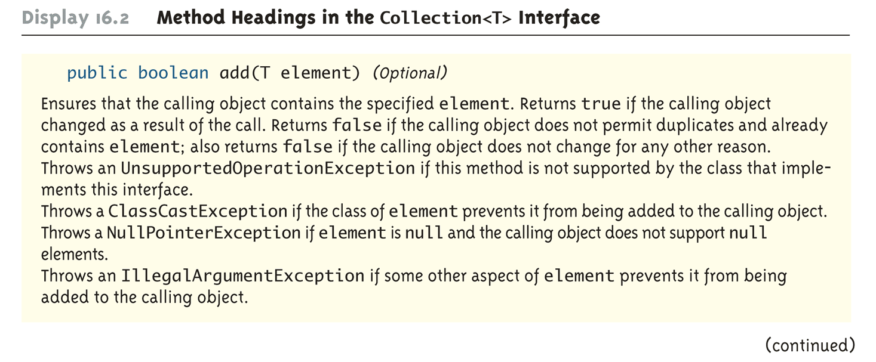
Method Headings in the Collection<T> Interface (Part 7 of 10)

Slide 14
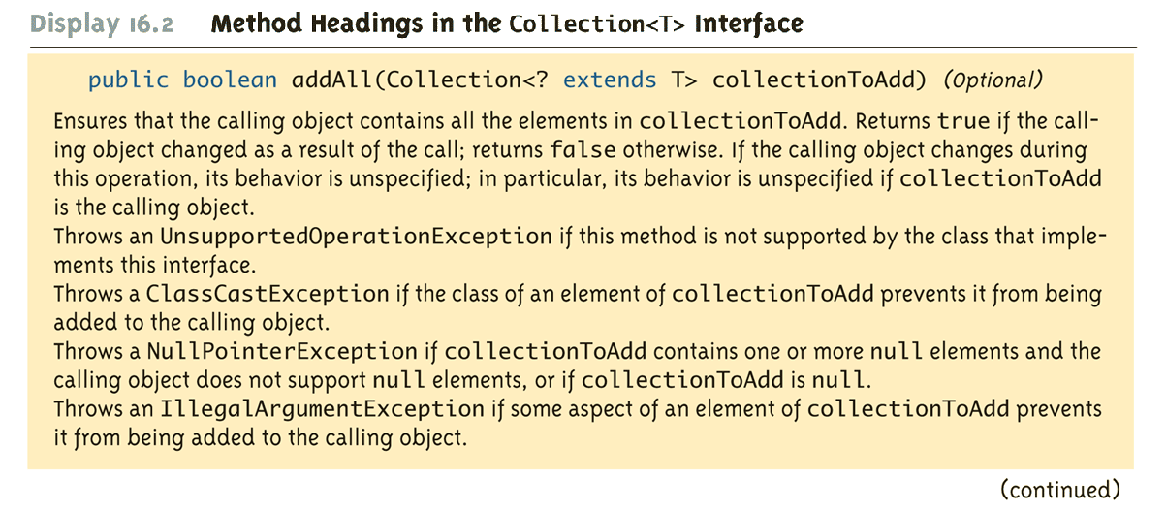
Method Headings in the Collection<T> Interface (Part 8 of 10)

Slide 15
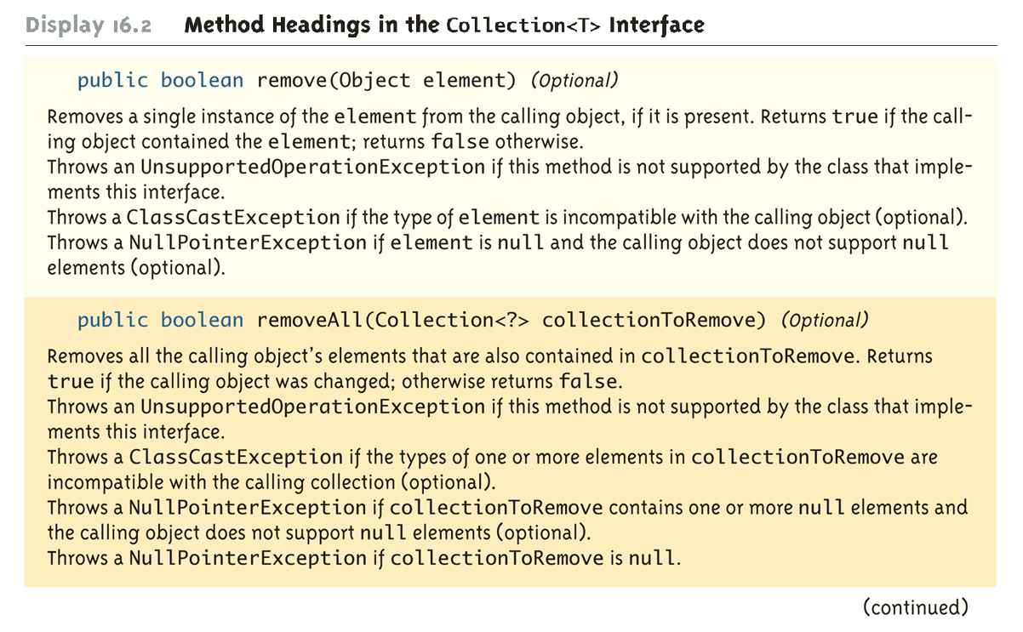
Method Headings in the Collection<T> Interface (Part 9 of 10)

Slide 16
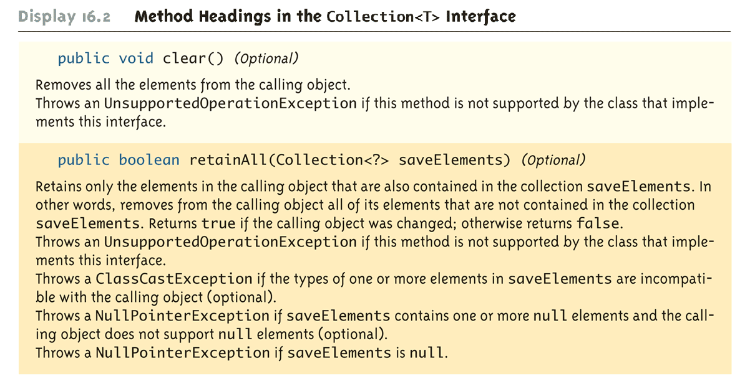
Method Headings in the Collection<T> Interface (Part 10 of 10)

Slide 17
Collection Relationships
There are a number of different predefined classes that implement the Collection<T> interface
Programmer defined classes can implement it also
A method written to manipulate a parameter of type Collection<T> will work for all of these classes, either singly or intermixed
There are two main interfaces that extend the Collection<T> interface: The Set<T> interface and the List<T> interface

Slide 18
Collection Relationships
Classes that implement the Set<T> interface do not allow an element in the class to occur more than once
The Set<T> interface has the same method headings as the Collection<T> interface, but in some cases the semantics (intended meanings) are different
Methods that are optional in the Collection<T> interface are required in the Set<T> interface

Slide 19
Collection Relationships
Classes that implement the List<T> interface have their elements ordered as on a list
Elements are indexed starting with zero
A class that implements the List<T> interface allows elements to occur more than once
The List<T> interface has more method headings than the Collection<T> interface
Some of the methods inherited from the Collection<T> interface have different semantics in the List<T> interface
The ArrayList<T> class implements the List<T> interface

Slide 20
Methods in the Set<T>
The Set<T> interface has the same method headings as the Collection<T> interface, but in some cases the semantics are different. For example the add methods:
The Set<T> interface is in the java.util package.
The Set<T> interface extends the Collection<T> interface and has all the same method headings given in Display 16.2. However, the semantics of the add methods vary as described below.
public boolean add(T element) (Optional)
If element is not already in the calling object, element is added to the calling object and true is returned. If element is in the calling object, the calling object is unchanged and false is returned.
public boolean addAll(Collection<? extends T> collectionToAdd) (Optional)
Ensures that the calling object contains all the elements in collectionToAdd. Returns true if the calling object changed as a result of the call; returns false otherwise. Thus, if collectionToAdd is a Set<T>, then the calling object is changed to the union of itself with collectionToAdd.

Slide 21
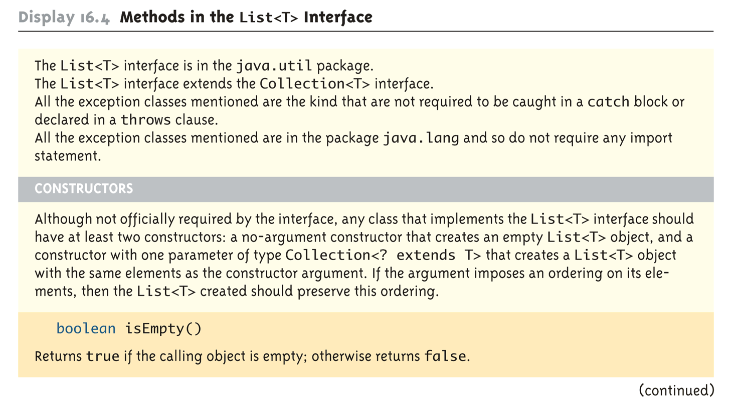
Methods in the List<T> Interface (Part 1 of 16)
The List<T> interface has more method headings than the Collection<T> interface.

Slide 22
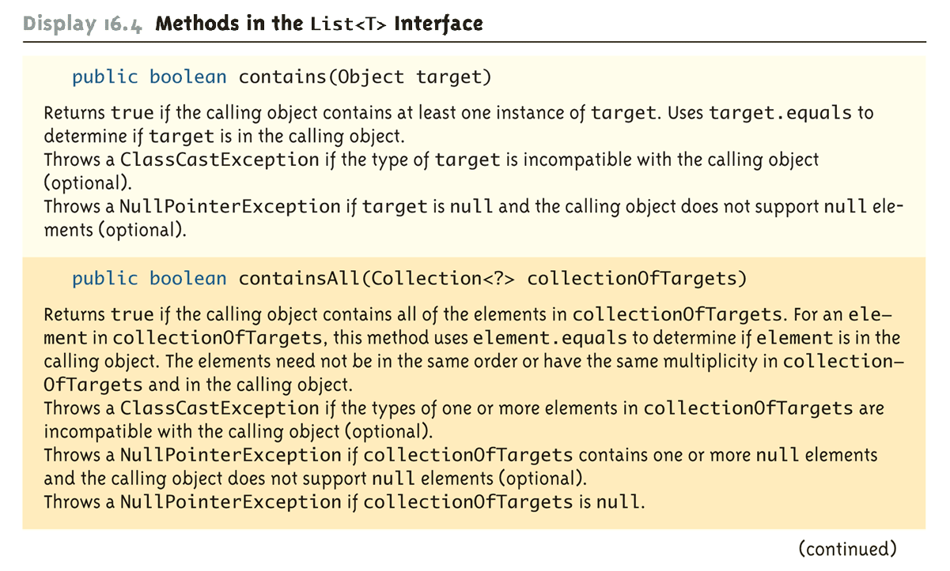
Methods in the List<T> Interface (Part 2 of 16)

Slide 23
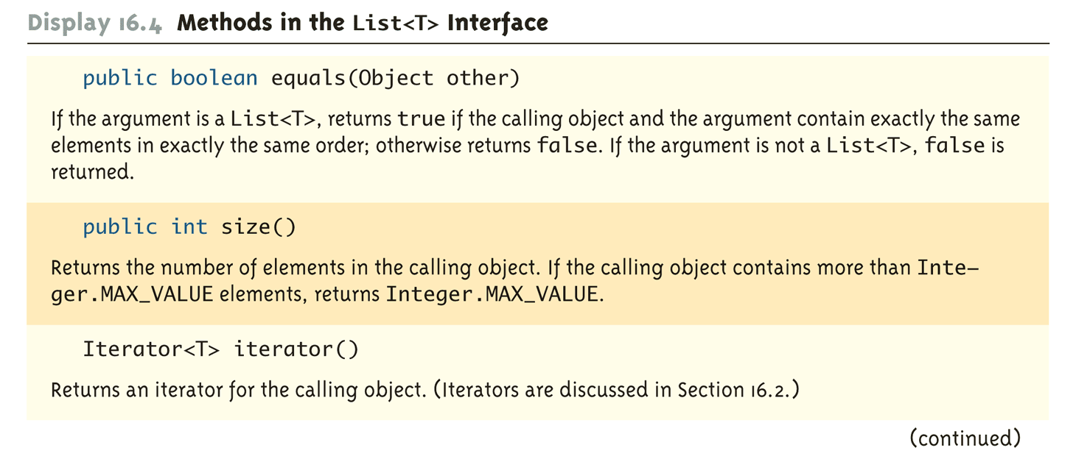
Methods in the List<T> Interface (Part 3 of 16)

Slide 24
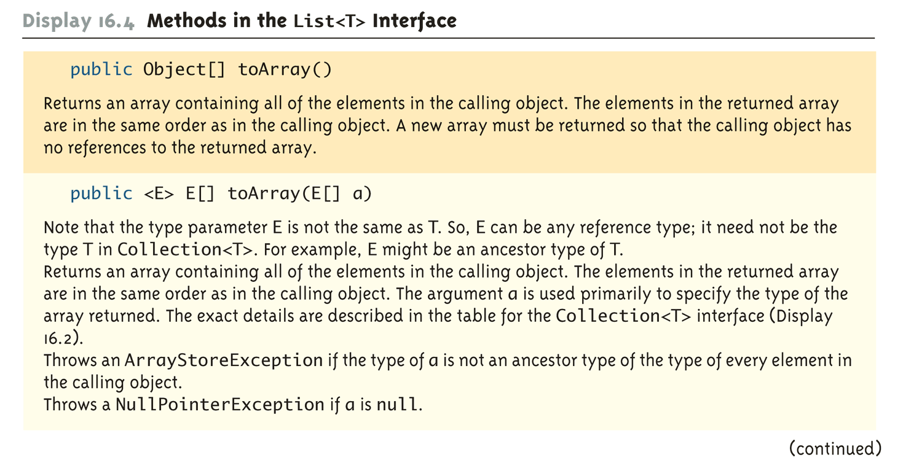
Methods in the List<T> Interface (Part 4 of 16)

Slide 25
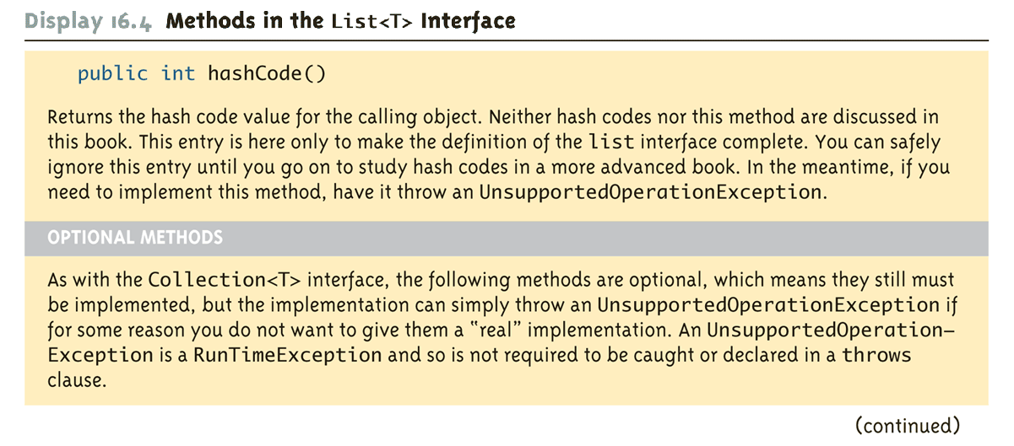
Methods in the List<T> Interface (Part 5 of 16)

Slide 26
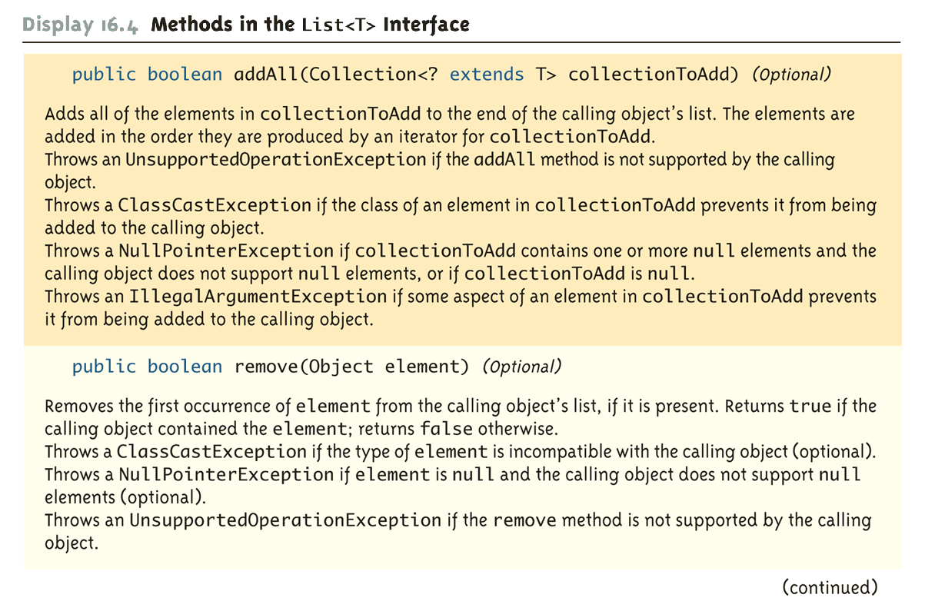
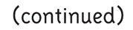
Methods in the List<T> Interface (Part 6 of 16)

Slide 27
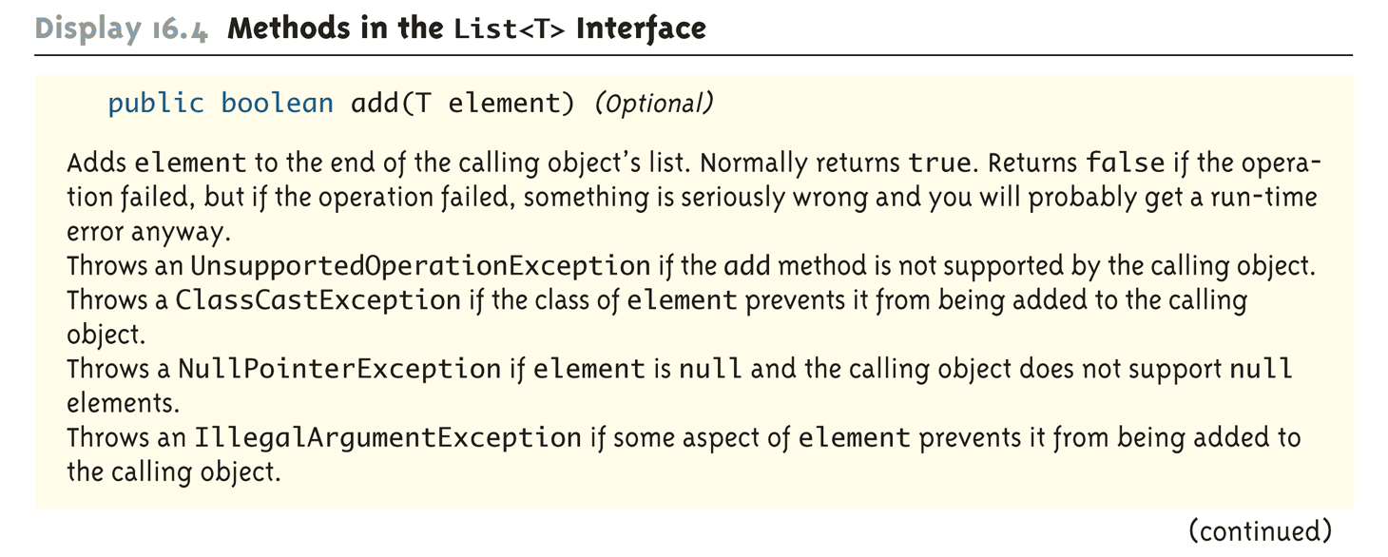
Methods in the List<T> Interface (Part 7 of 16)

Slide 28
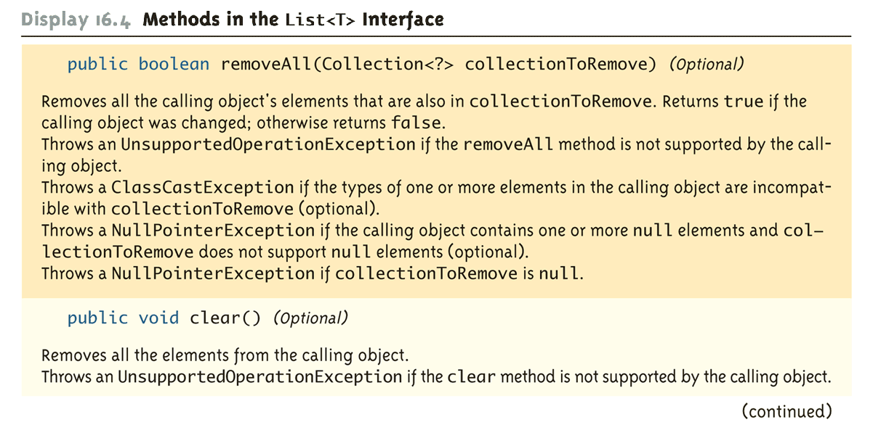
Methods in the List<T> Interface (Part 8 of 16)

Slide 29
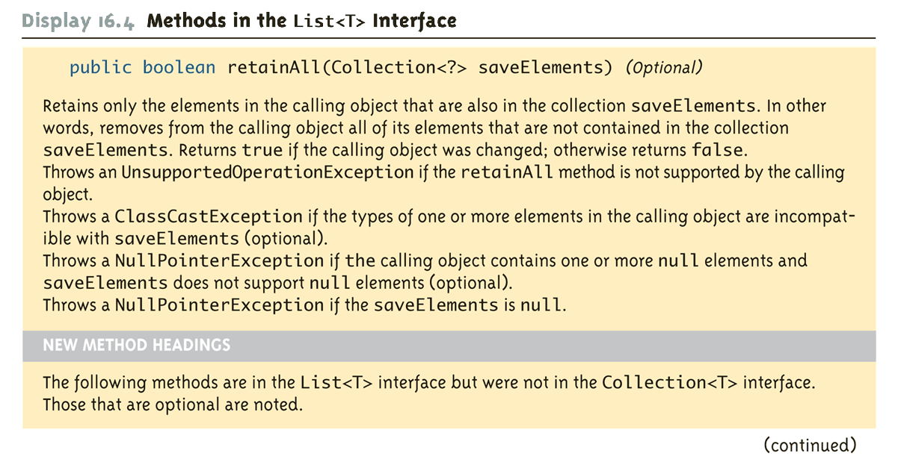
Methods in the List<T> Interface (Part 9 of 16)

Slide 30
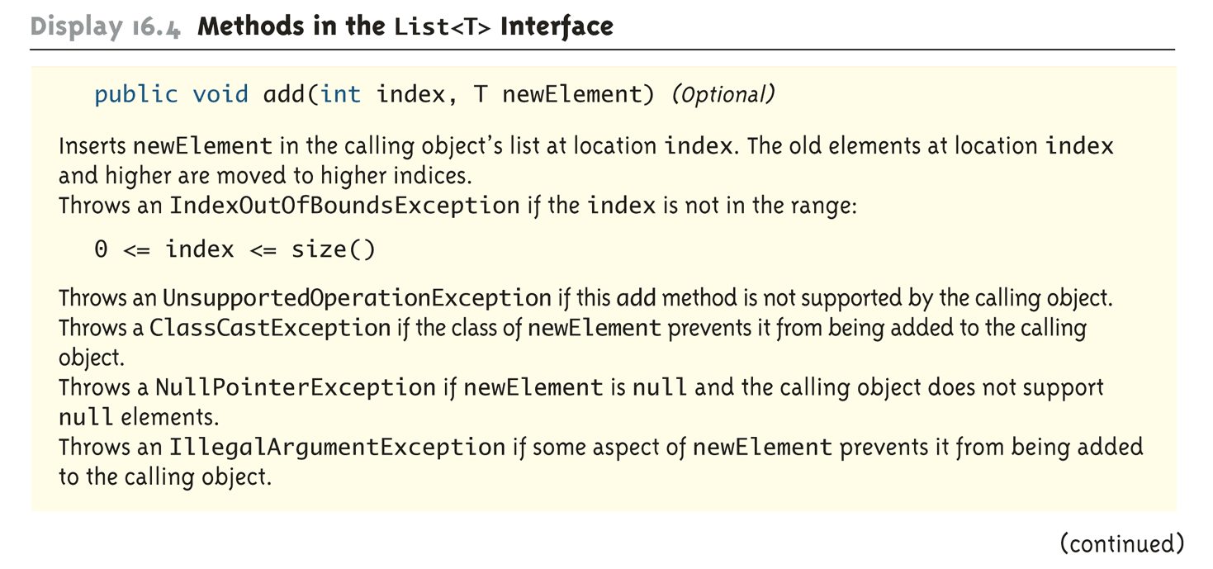
Methods in the List<T> Interface (Part 10 of 16)

Slide 31
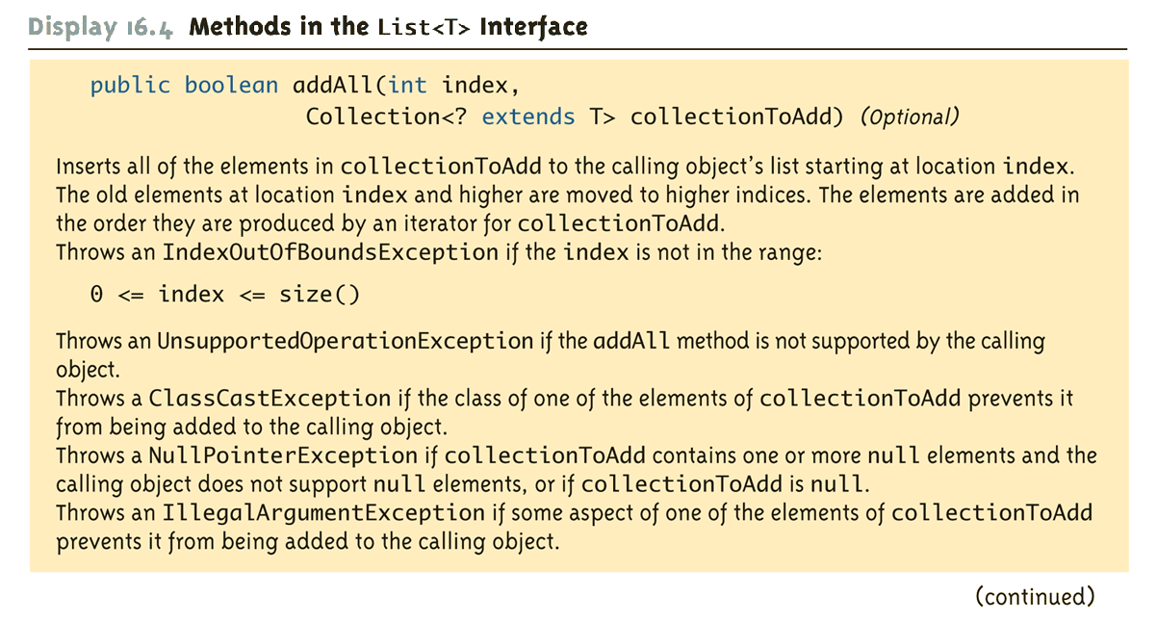
Methods in the List<T> Interface (Part 11 of 16)

Slide 32
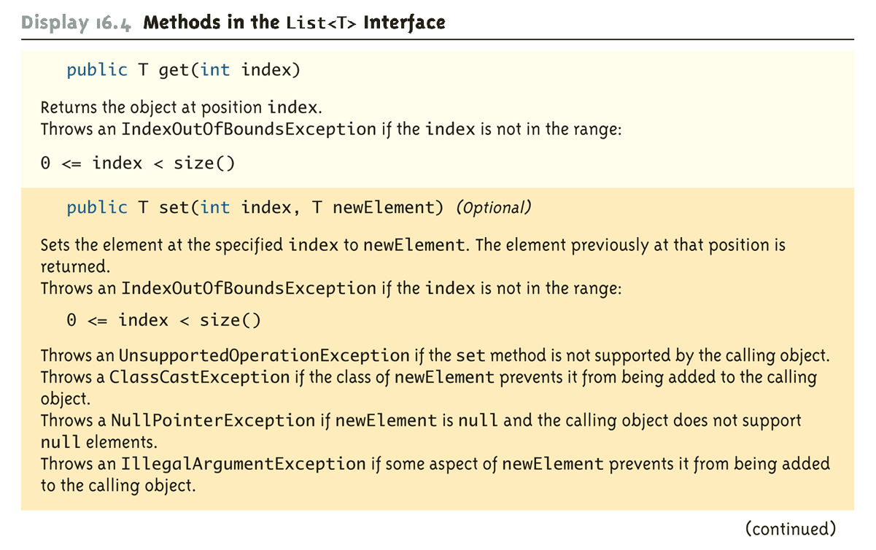
Methods in the List<T> Interface (Part 12 of 16)

Slide 33
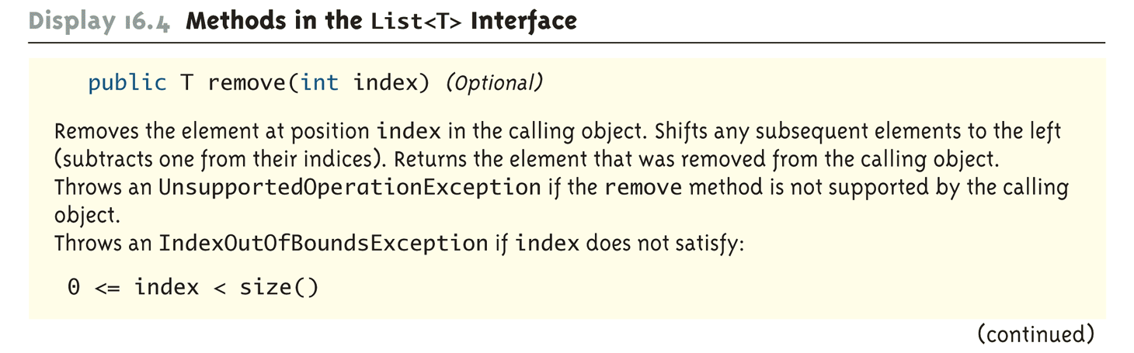
Methods in the List<T> Interface (Part 13 of 16)

Slide 34
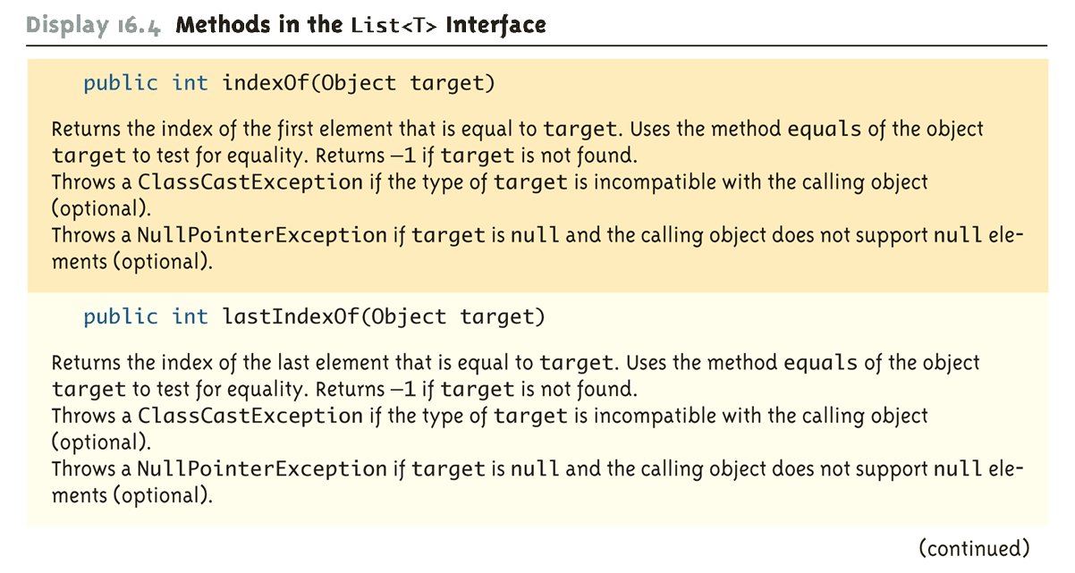
Methods in the List<T> Interface (Part 14 of 16)

Slide 35
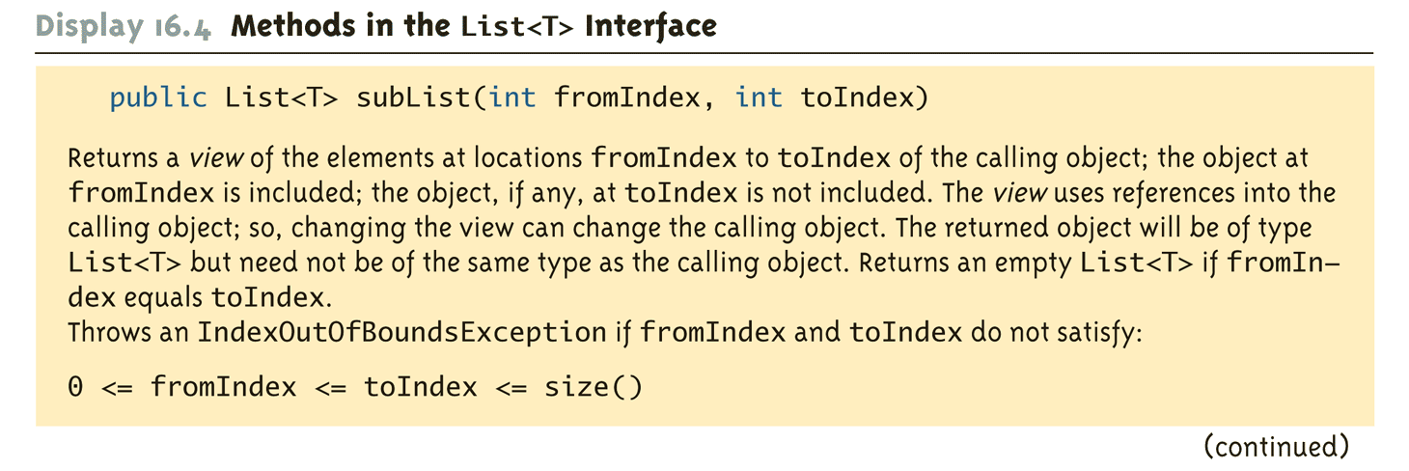
Methods in the List<T> Interface (Part 15 of 16)

Slide 36
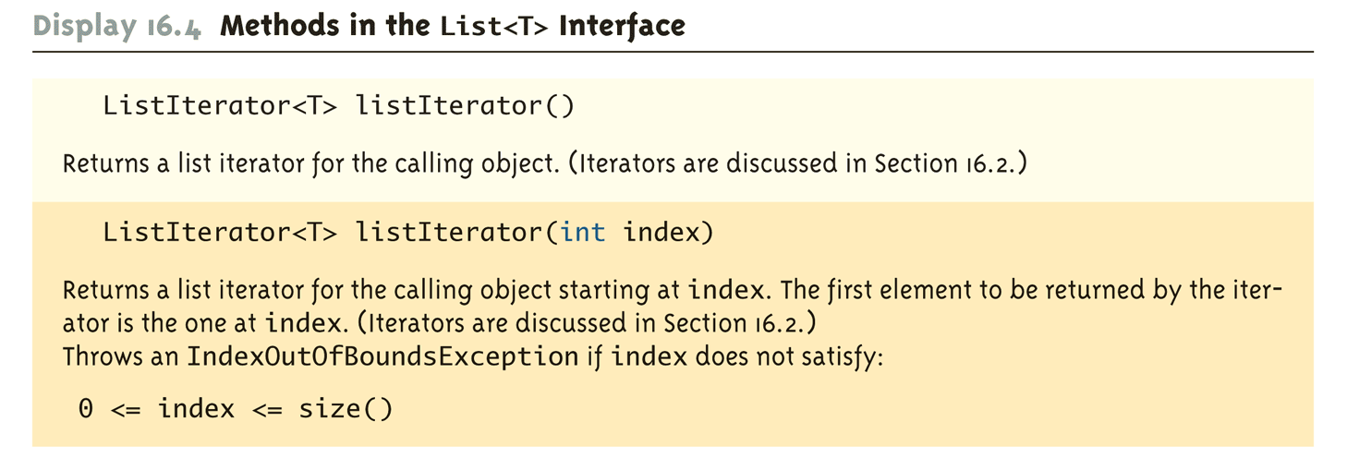
Methods in the List<T> Interface (Part 16 of 16)

Slide 37
Pitfall: Optional Operations
When an interface lists a method as "optional," it must still be implemented in a class that implements the interface
The optional part means that it is permitted to write a method that does not completely implement its intended semantics
However, if a trivial implementation is given, then the method body should throw an UnsupportedOperationException

Slide 38
Tip: Dealing with All Those Exceptions
The tables of methods for the various collection interfaces and classes indicate that certain exceptions are thrown
These are unchecked exceptions, so they are useful for debugging, but need not be declared or caught
In an existing collection class, they can be viewed as run-time error messages
In a derived class of some other collection class, most or all of them will be inherited
In a collection class defined from scratch, if it is to implement a collection interface, then it should throw the exceptions that are specified in the interface

Slide 39
Concrete Collections Classes
The concrete class HashSet<T> implements the Set<T> interface, and can be used if additional methods are not needed
The HashSet<T> class implements all the methods in the Set<T> interface, and adds only constructors
The HashSet<T> class is implemented using a hash table
The ArrayList<T> and Vector<T> classes implement the List<T> interface, and can be used if additional methods are not needed
Both the ArrayList<T> and Vector<T> interfaces implement all the methods in the interface List<T>
Either class can be used when a List<T> with efficient random access to elements is needed

Slide 40
Concrete Collections Classes
The concrete class LinkedList<T> is a concrete derived class of the abstract class AbstractSequentialList<T>
When efficient sequential movement through a list is needed, the LinkedList<T> class should be used
The interface SortedSet<T> and the concrete class TreeSet<T> are designed for implementations of the Set<T> interface that provide for rapid retrieval of elements
The implementation of the class is similar to a binary tree, but with ways to do inserting that keep the tree balanced

Slide 41
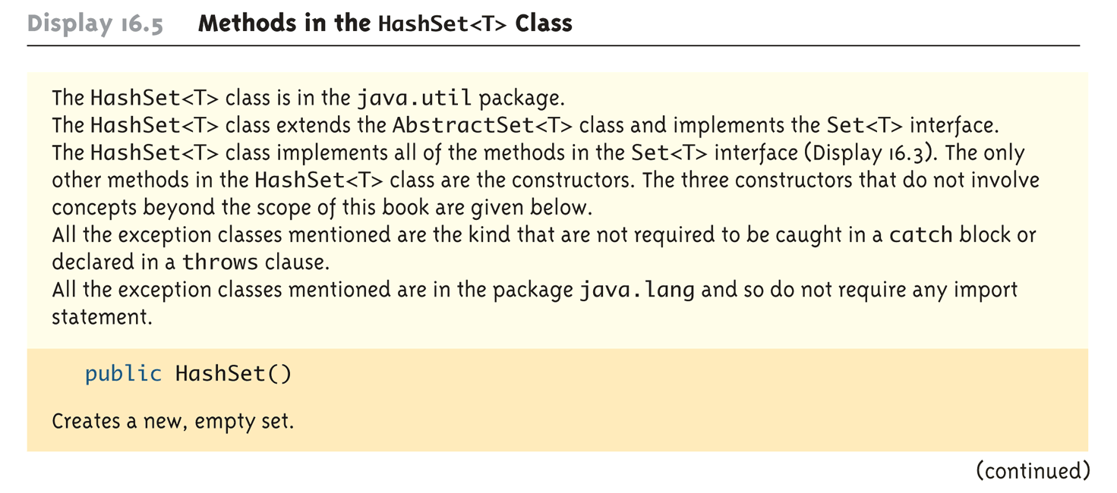
Methods in the HashSet<T> Class (Part 1 of 2)

Slide 42
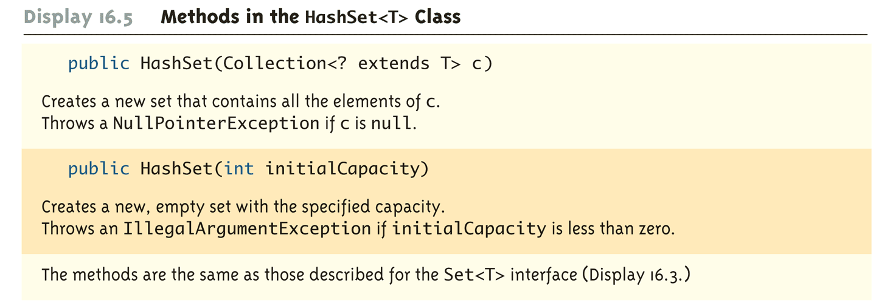
Methods in the HashSet<T> Class (Part 2 of 2)

Slide 43
HashSet<T> Class Demo (1 of 4)
1 import java.util.HashSet;
2 import java.util.Iterator;
3 public class HashSetDemo
4 {
5 private static void outputSet(HashSet<String> set)
6 {
7 Iterator<String> i = set.iterator( );
8 while (i.hasNext( ))
9 System.out.print(i.next( ) + " ");
10 System.out.println();
11 }
12 public static void main(String[] args)
13 {
14 HashSet<String> round = new HashSet<String>( );
15 HashSet<String> green = new HashSet<String>( );
16 // Add some data to each set
17 round.add("peas");
18 round.add("ball");
19 round.add("pie");
20 round.add("grapes");

Slide 44
HashSet<T> Class Demo (2 of 4)
25 System.out.println("Contents of set round: ");
26 outputSet(round);
27 System.out.println("\nContents of set green: ");
28 outputSet(green);
29 System.out.println("\nball in set 'round'? " +
30 round.contains("ball"));
31 System.out.println("ball in set 'green'? " +
32 green.contains("ball"));
33 System.out.println("\nball and peas in same set? " +
34 ((round.contains("ball") &&
35 (round.contains("peas"))) ||
36 (green.contains("ball") &&
37 (green.contains("peas")))));
38 System.out.println("pie and grass in same set? " +
39 ((round.contains("pie") &&
40 (round.contains("grass"))) ||
41 (green.contains("pie") &&
42 (green.contains("grass")))));

Slide 45
HashSet<T> Class Demo (3 of 4)
43 // To union two sets we use the addAll method.
44 HashSet<String> setUnion = new HashSet<String>(round);
45 round.addAll(green);
46 System.out.println("\nUnion of green and round:");
47 outputSet(setUnion);
48 // To intersect two sets we use the removeAll method.
49 HashSet<String> setInter = new HashSet<String>(round);
50 setInter.removeAll(green);
51 System.out.println("\nIntersection of green and round:");
52 outputSet(setInter);
53 System.out.println();
54 }
}

Slide 46
HashSet<T> Class Demo (4 of 4)
Sample Dialogue
Contents of set round:
grapes pie ball peas
Contents of set green:
grass garden hose grapes peas
ball in set round? true
ball in set green? false
ball and peas in same set? true
pie and grass in same set? false
Union of green and round:
garden hose grass peas ball pie grapes
Intersection of green and round:
peas grapes

Slide 47
Using HashSet with your own Class
If you intend to use the HashSet<T> class with your own class as the parameterized type T , then your class must override the following methods:
public int hashCode();
Ideally returns a unique integer for this object
public boolean equals(Object obj);
Indicates whether or not the reference object is the same as the parameter obj

Slide 48
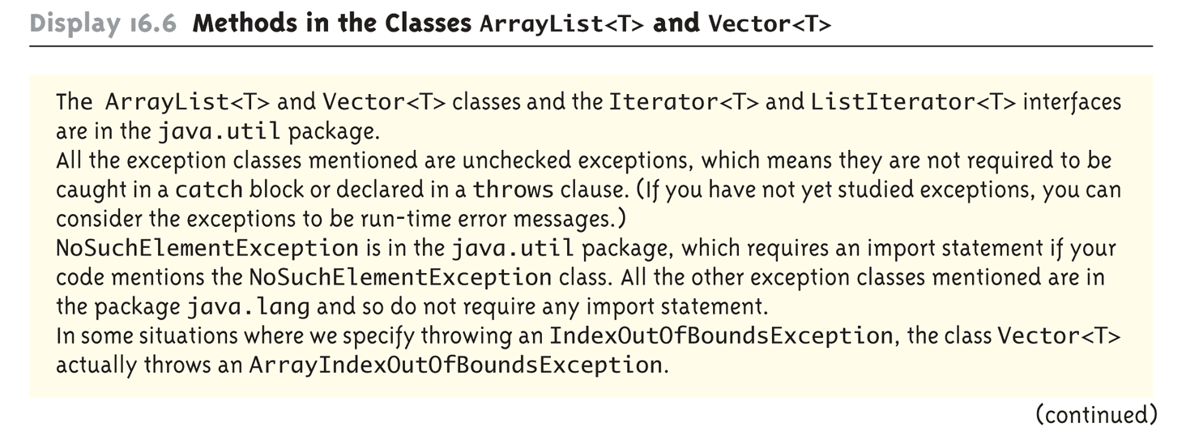
Methods in the Classes ArrayList<T> and Vector<T> (Part 1 of 15)

Slide 49
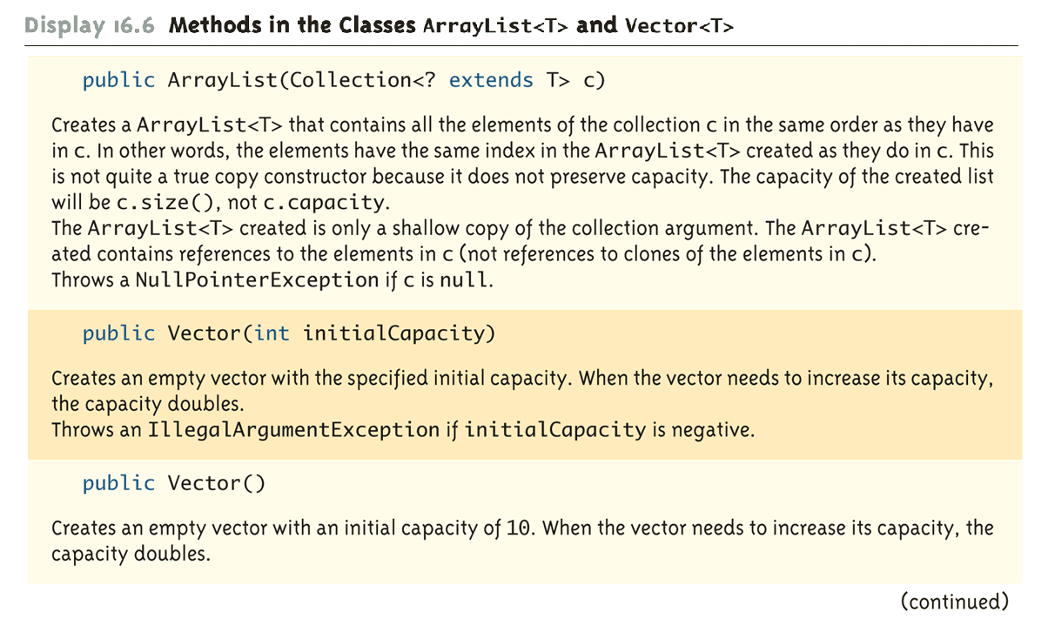
Methods in the Classes ArrayList<T> and Vector<T> (Part 2 of 15)

Slide 50
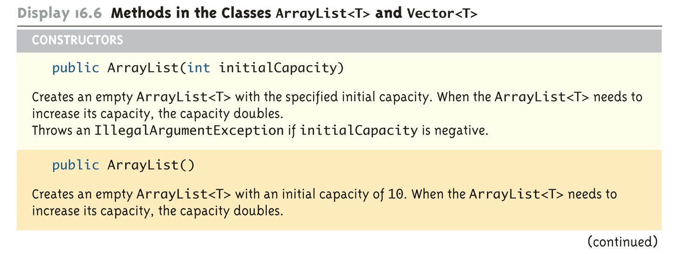
Methods in the Classes ArrayList<T> and Vector<T> (Part 3 of 15)

Slide 51
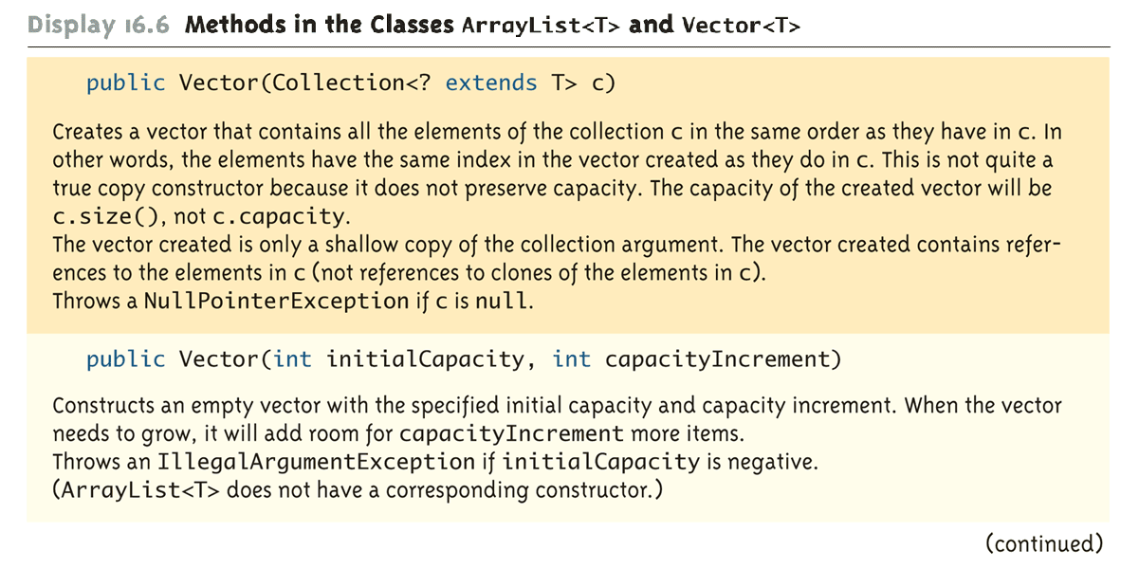
Methods in the Classes ArrayList<T> and Vector<T> (Part 4 of 15)

Slide 52
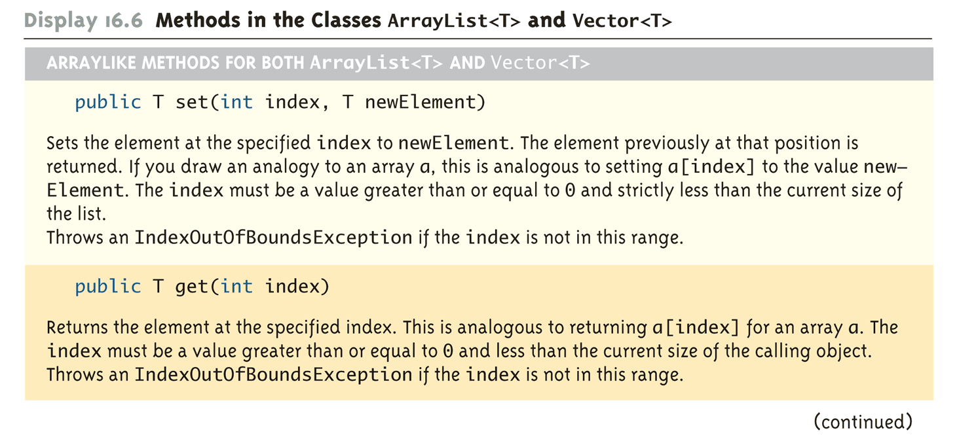
Methods in the Classes ArrayList<T> and Vector<T> (Part 5 of 15)

Slide 53
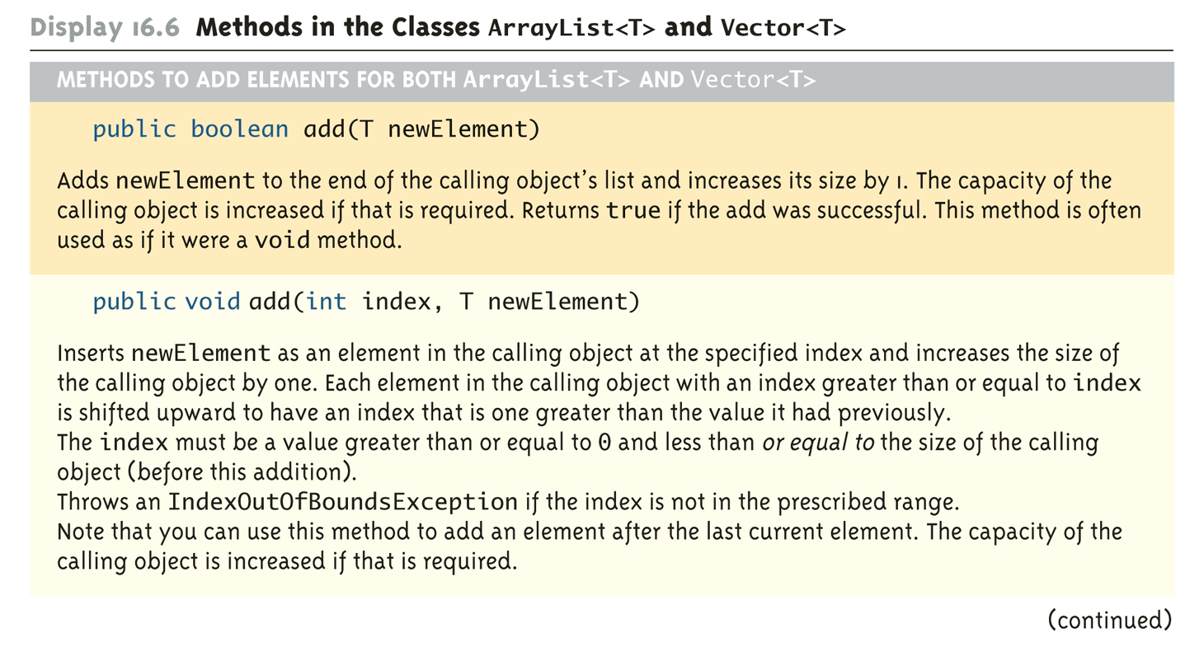
Methods in the Classes ArrayList<T> and Vector<T> (Part 6 of 15)

Slide 54
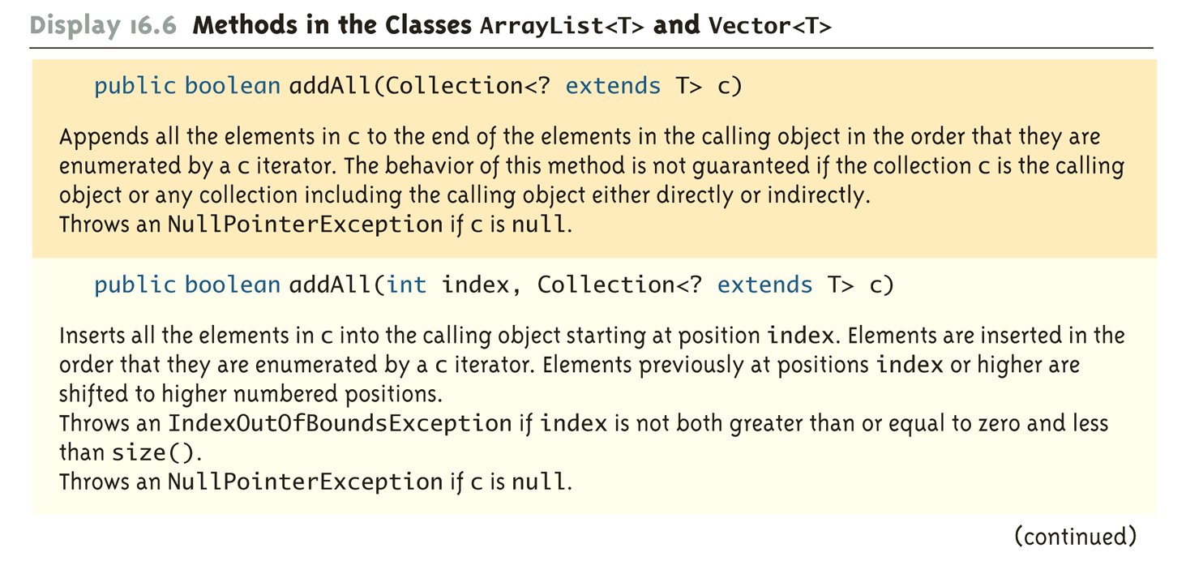
Methods in the Classes ArrayList<T> and Vector<T> (Part 7 of 15)

Slide 55
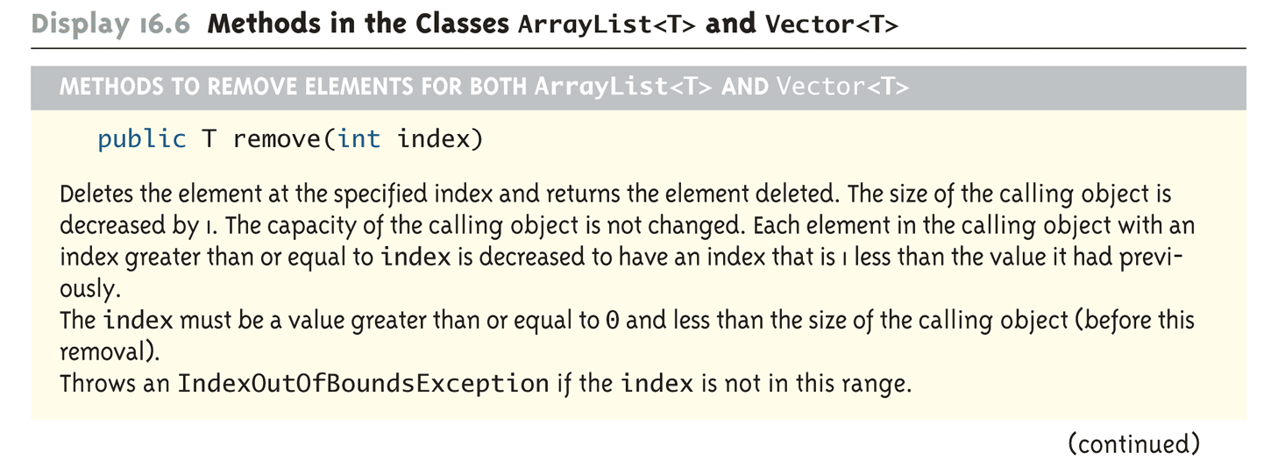
Methods in the Classes ArrayList<T> and Vector<T> (Part 8 of 15)

Slide 56
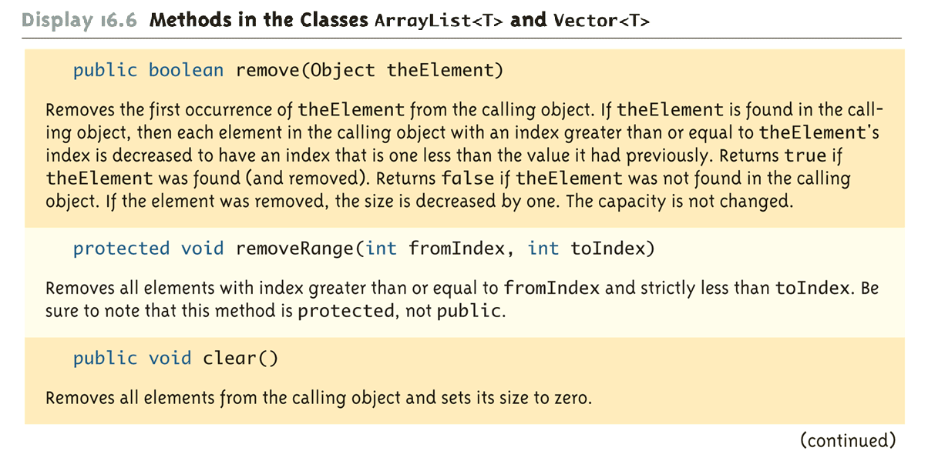
Methods in the Classes ArrayList<T> and Vector<T> (Part 9 of 15)

Slide 57
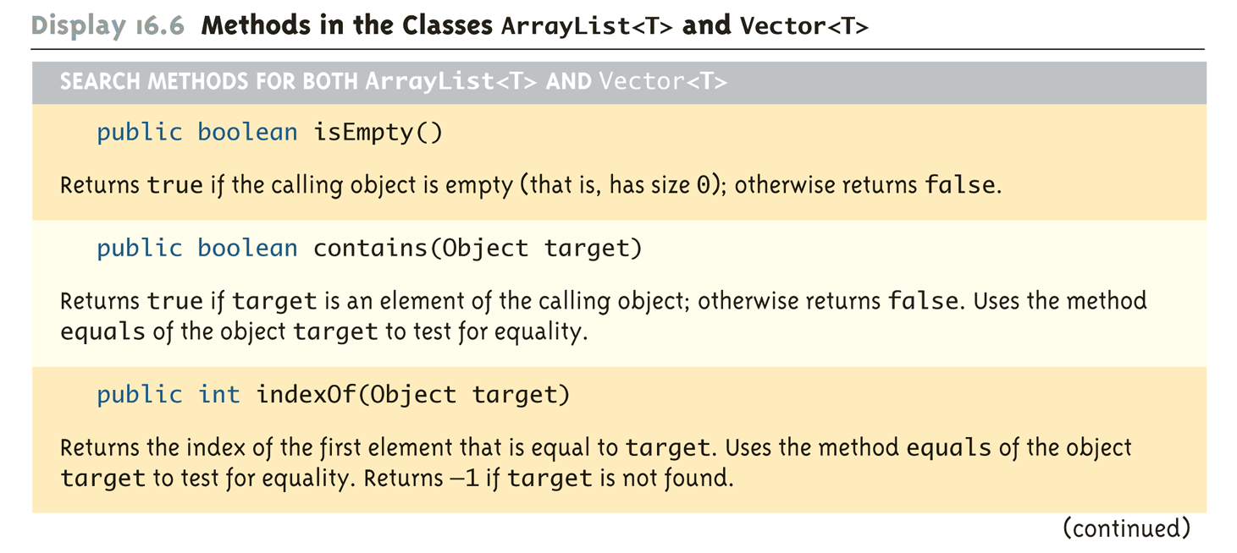
Methods in the Classes ArrayList<T> and Vector<T> (Part 10 of 15)

Slide 58
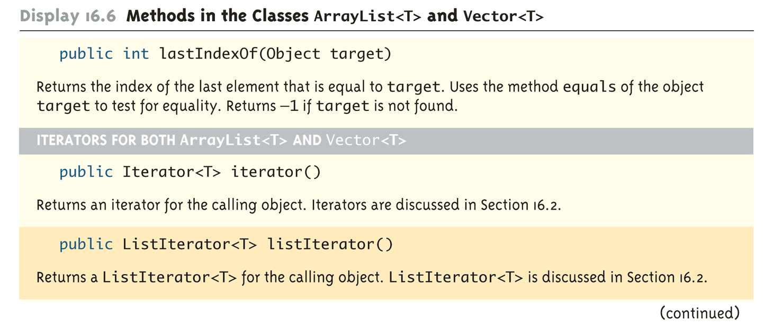
Methods in the Classes ArrayList<T> and Vector<T> (Part 11 of 15)

Slide 59
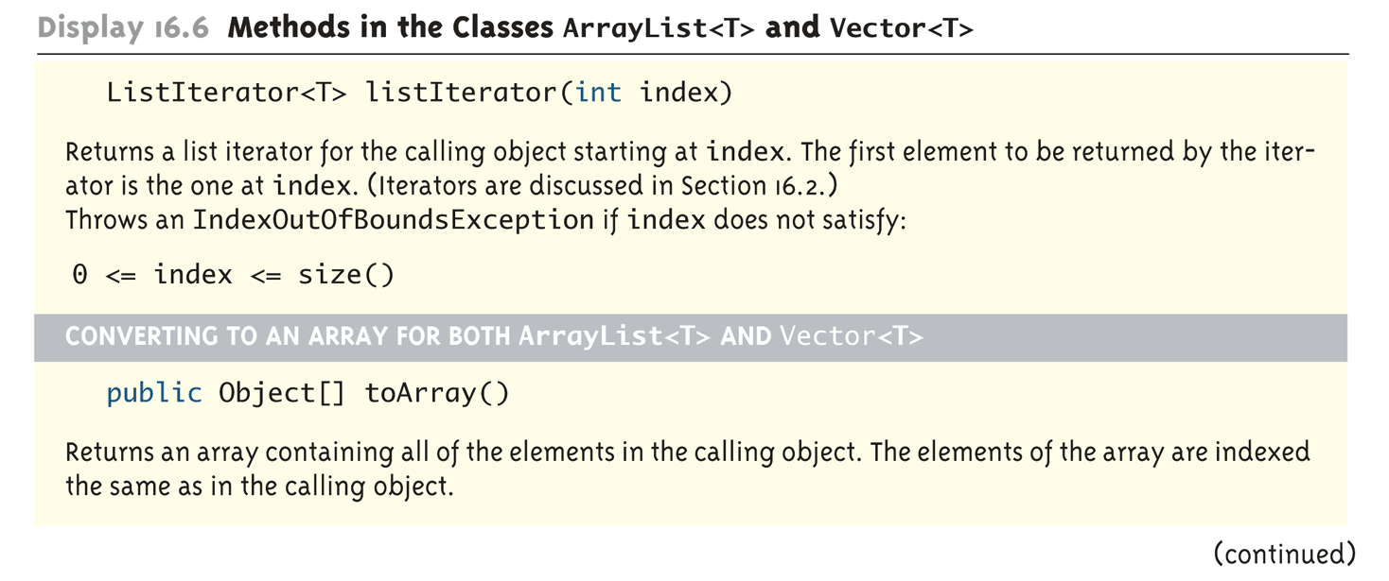
Methods in the Classes ArrayList<T> and Vector<T> (Part 12 of 15)

Slide 60
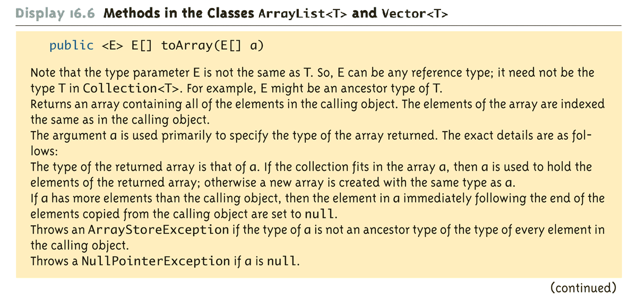
Methods in the Classes ArrayList<T> and Vector<T> (Part 13 of 15)

Slide 61
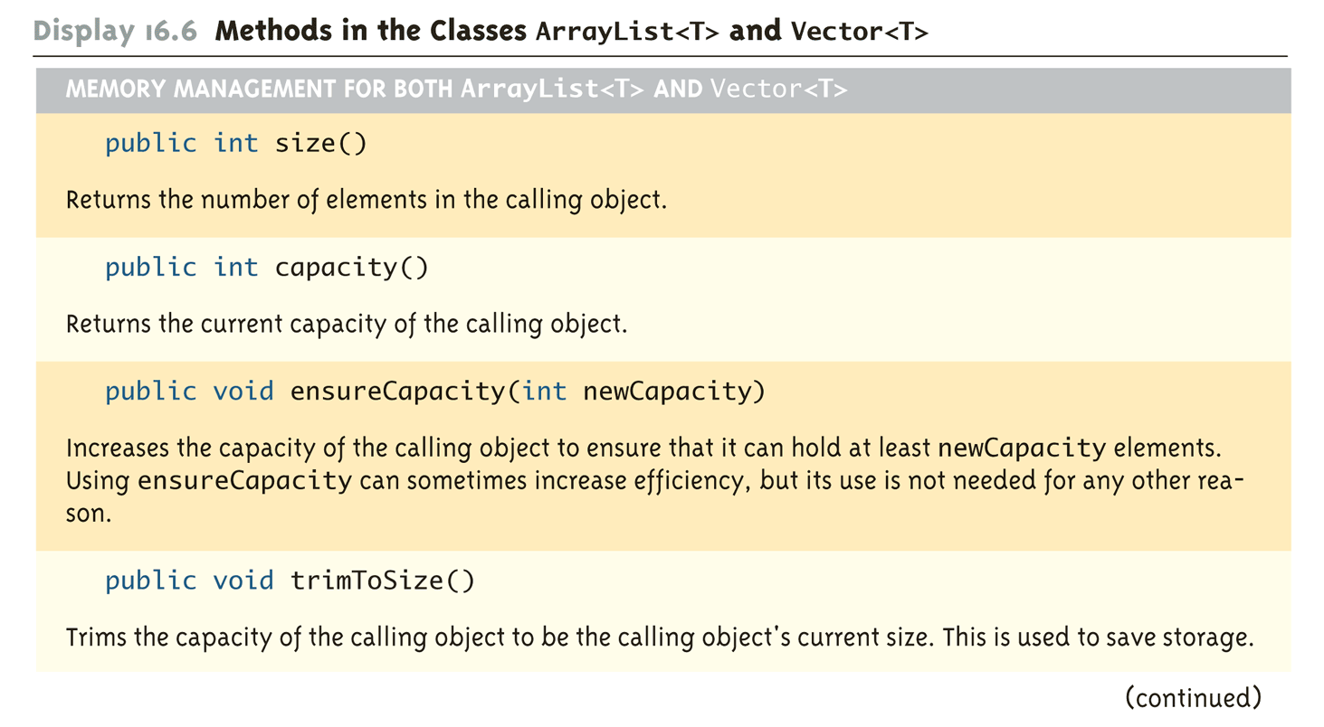
Methods in the Classes ArrayList<T> and Vector<T> (Part 14 of 15)

Slide 62
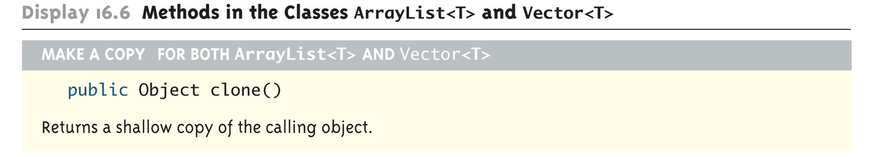
Methods in the Classes ArrayList<T> and Vector<T> (Part 15 of 15)

Slide 63
Differences Between ArrayList<T> and Vector<T>
For most purposes, the ArrayList<T> and Vector<T> are equivalent
The Vector<T> class is older, and had to be retrofitted with extra method names to make it fit into the collection framework
The ArrayList<T> class is newer, and was created as part of the Java collection framework
The ArrayList<T> class is supposedly more efficient than the Vector<T> class also

Slide 64
Pitfall: Omitting the <T>
When the <T> or corresponding class name is omitted from a reference to a collection class, this is an error for which the compiler may or may not issue an error message (depending on the details of the code), and even if it does, the error message may be quite strange
Look for a missing <T> or <ClassName> when a program that uses collection classes gets a strange error message or doesn't run correctly

Slide 65
The Map Framework
The Java map framework deals with collections of ordered pairs
For example, a key and an associated value
Objects in the map framework can implement mathematical functions and relations, so can be used to construct database classes
The map framework uses the Map<T> interface, the AbstractMap<T> class, and classes derived from the AbstractMap<T> class

Slide 66
The Map Landscape

Slide 67
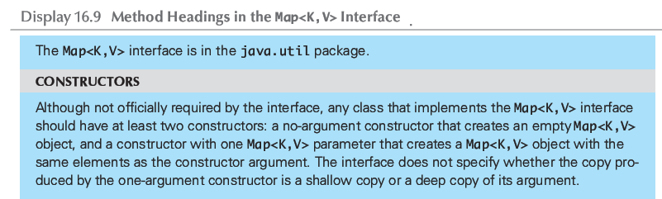
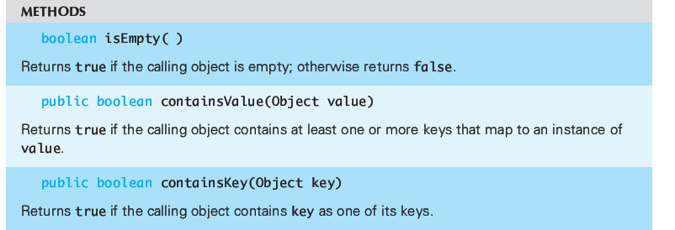
The Map<K,V> Interface (1 of 3)

Slide 68
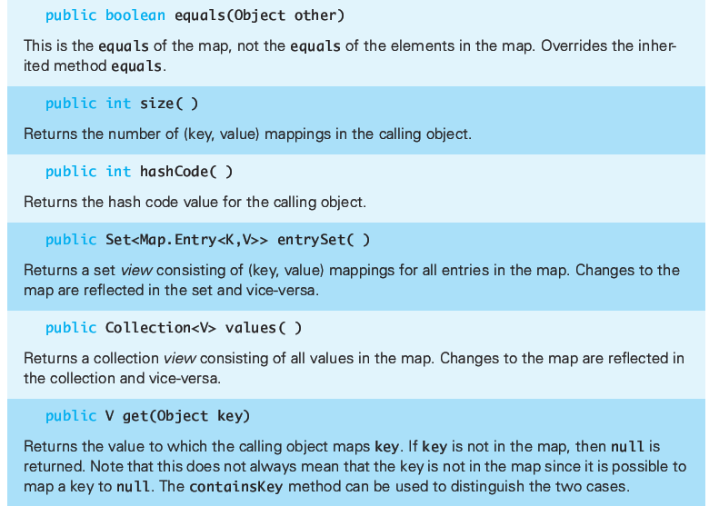
The Map<K,V> Interface (2 of 3)

Slide 69
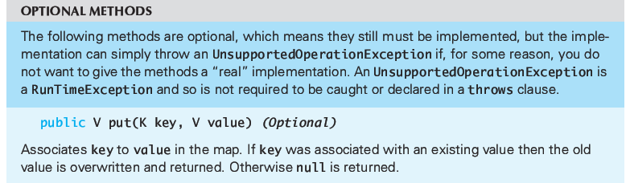

The Map<K,V> Interface (3 of 3)

Slide 70
Concrete Map Classes
Normally you will use an instance of a Concrete Map Class
Here we discuss the HashMap<K,V> Class
Internally, the class uses a hash table similar to what was discussed in Chapter 15.
No guarantee as to the order of elements placed in the map.
If you require order then you should use the TreeMap<K,V> class or the LinkedHashMap<K,V> class

Slide 71
HashMap<K,V> Class
The initial capacity specifies how many “buckets” exist in the hash table.
This would be analogous to the size of the array of the hash table covered in Chapter 15.
A larger initial capacity results in faster performance but uses more memory
The load factor is a number between 0 and 1.
This variable specifies a percentage such that if the number of elements added to the hash table exceeds the load factor then the capacity of the hash table is automatically increased.
The default load factor is 0.75 and the default initial capacity is 16

Slide 72

The HashMap<K,V> Class (1 of 2)

Slide 73

The HashMap<K,V> Class (2 of 2)
All of the Map Interface methods are supported, such as get
and put

Slide 74
HashMap Example (1 of 3)
1 // This class uses the Employee class defined in Chapter 7.
2 import java.util.HashMap;
3 import java.util.Scanner;
4 public class HashMapDemo
5 {
6 public static void main(String[] args)
7 {
8 // First create a hashmap with an initial size of 10 and
9 // the default load factor
10 HashMap<String,Employee> employees =
11 new HashMap<String,Employee>(10);
12 // Add several employees objects to the map using
13 // their name as the key
14 employees.put("Joe",
15 new Employee("Joe",new Date("September", 15, 1970)));
16 employees.put("Andy",
17 new Employee("Andy",new Date("August", 22, 1971)));
18 employees.put("Greg",
19 new Employee("Greg",new Date("March", 9, 1972)));
20 employees.put("Kiki",
21 new Employee("Kiki",new Date("October", 8, 1970)));
22 employees.put("Antoinette",
23 new Employee("Antoinette",new Date("May", 2, 1959)));
24 System.out.print("Added Joe, Andy, Greg, Kiki, ");
25 System.out.println("and Antoinette to the map.");

Slide 75
HashMap Example (2 of 3)
26 // Ask the user to type a name. If found in the map,
27 // print it out.
28 Scanner keyboard = new Scanner(System.in);
29 String name = "";
30 do
31 {
32 System.out.print("\nEnter a name to look up in the map. ");
33 System.out.println("Press enter to quit.");
34 name = keyboard.nextLine();
35 if (employees.containsKey(name))
36 {
37 Employee e = employees.get(name);
38 System.out.println("Name found: " + e.toString());
39 }
40 else if (!name.equals(""))
41 {
42 System.out.println("Name not found.");
43 }
44 } while (!name.equals(""));
45 }
46 }

Slide 76
HashMap Example (3 of 3)
SAMPLE DIALOGUE
Added Joe, Andy, Greg, Kiki, and Antoinette to the map.
Enter a name to look up in the map. Press enter to quit.
Joe
Name found: Joe September 15, 1970
Enter a name to look up in the map. Press enter to quit.
Andy
Name found: Andy August 22, 1971
Enter a name to look up in the map. Press enter to quit.
Kiki
Name found: Kiki October 8, 1970
Enter a name to look up in the map. Press enter to quit.
Myla
Name not found.

Slide 77
Using HashMap with your own Class
Just like the HashSet class, If you intend to use the HashMap<K,V> class with your own class as the parameterized type K , then your class must override the following methods:
public int hashCode();
Ideally returns a unique integer for this object
public boolean equals(Object obj);
Indicates whether or not the reference object is the same as the parameter obj

Slide 78
Iterators
An iterator is an object that is used with a collection to provide sequential access to the collection elements
This access allows examination and possible modification of the elements
An iterator imposes an ordering on the elements of a collection even if the collection itself does not impose any order on the elements it contains
If the collection does impose an ordering on its elements, then the iterator will use the same ordering

Slide 79
The Iterator<T> Interface
Java provides an Iterator<T> interface
Any object of any class that satisfies the Iterator<T> interface is an Iterator<T>
An Iterator<T> does not stand on its own
It must be associated with some collection object using the method iterator
If c is an instance of a collection class (e.g., HashSet<String>), the following obtains an iterator for c:
Iterator iteratorForC = c.iterator();

Slide 80

Methods in the Iterator<T> Interface (Part 1 of 2)

Slide 81

Methods in the Iterator<T> Interface (Part 2 of 2)

Slide 82
Using an Iterator with a HashSet<T> Object
A HashSet<T> object imposes no order on the elements it contains
However, an iterator will impose an order on the elements in the hash set
That is, the order in which they are produced by next()
Although the order of the elements so produced may be duplicated for each program run, there is no requirement that this must be the case

Slide 83

An Iterator (Part 1 of 3)

Slide 84

An Iterator (Part 2 of 3)

Slide 85

An Iterator (Part 3 of 3)

Slide 86
Tip: For-Each Loops as Iterators
Although it is not an iterator, a for-each loop can serve the same purpose as an iterator
A for-each loop can be used to cycle through each element in a collection
For-each loops can be used with any of the collections discussed here

Slide 87

For-Each Loops as Iterators (Part 1 of 2)

Slide 88

For-Each Loops as Iterators (Part 2 of 2)

Slide 89
The ListIterator<T> Interface
The ListIterator<T> interface extends the Iterator<T> interface, and is designed to work with collections that satisfy the List<T> interface
A ListIterator<T> has all the methods that an Iterator<T> has, plus additional methods
A ListIterator<T> can move in either direction along a list of elements
A ListIterator<T> has methods, such as set and add, that can be used to modify elements

Slide 90

Methods in the ListIterator<T> Interface (Part 1 of 4)

Slide 91

Methods in the ListIterator<T> Interface (Part 2 of 4)

Slide 92

Methods in the ListIterator<T> Interface (Part 3 of 4)

Slide 93

Methods in the ListIterator<T> Interface (Part 4 of 4)

Slide 94
The ListIterator<T> Cursor
Every ListIterator<T> has a position marker known as the cursor
If the list has n elements, they are numbered by indices 0 through n-1, but there are n+1 cursor positions
When next() is invoked, the element immediately following the cursor position is returned and the cursor is moved forward one cursor position
When previous() is invoked, the element immediately before the cursor position is returned and the cursor is moved back one cursor position

Slide 95

ListIterator<T> Cursor Positions

Slide 96
Pitfall: next and previous Can Return a Reference
Theoretically, when an iterator operation returns an element of the collection, it might return a copy or clone of the element, or it might return a reference to the element
Iterators for the standard predefined collection classes, such as ArrayList<T> and HashSet<T>, actually return references
Therefore, modifying the returned value will modify the element in the collection

Slide 97

An Iterator Returns a Reference (Part 1 of 4)

Slide 98

An Iterator Returns a Reference (Part 2 of 4)

Slide 99

An Iterator Returns a Reference (Part 3 of 4)

Slide 100

An Iterator Returns a Reference (Part 4 of 4)

Slide 101
Tip: Defining Your Own Iterator Classes
There is usually little need for a programmer defined Iterator<T> or ListIterator<T> class
The easiest and most common way to define a collection class is to make it a derived class of one of the library collection classes
By doing this, the iterator() and listIterator() methods automatically become available to the program
If a collection class must be defined in some other way, then an iterator class should be defined as an inner class of the collection class

